Slide 1



Aca
Student ABC ID Creation
Process
www.abc.gov.in

Slide 2

Student ABC ID Creation Process
1
2
3
ABC ID Creation through DigiLocker
ABC ID Creation through ABC portal
Through Bulk ID option on NAD –Digilocker (AIs)
https://www.digilocker.gov.in/
https://www.abc.gov.in/
https://nad.digilocker.gov.in/

Slide 3
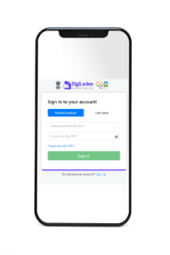
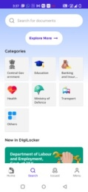
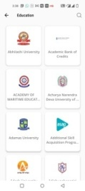
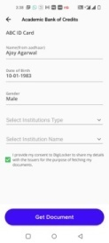
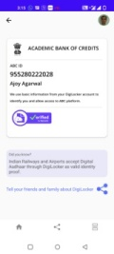





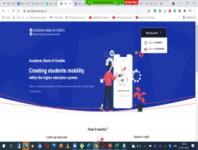

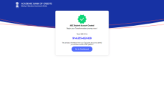
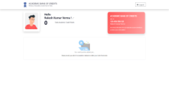
ABC ID Creation – Multiple Channels
Sign In/Sign Up
Select Education Category
Go to ABC ID Creation service
Select Institution
Fetch ABC ID Card
UMANG Mobile Application
Student​
AI/Portal
API Specification available over APISetu
ABC Portal
Login to abc.gov.in
Select your institution
Create ABC ID
View Credit Score

Slide 4



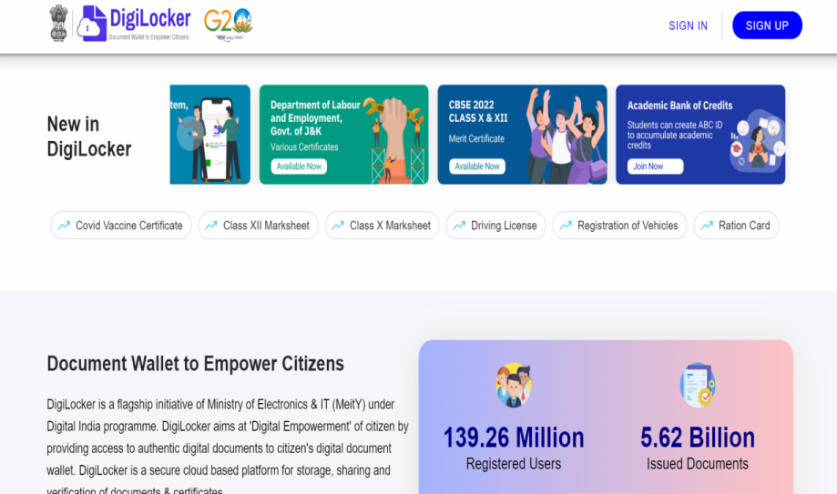
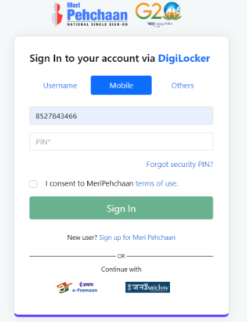
ABC ID Creation process - DigiLocker
www.digilocker.gov.in
Sign In/Sign Up
Select Education Category
Go to ABC ID Creation service
Select Institution
Fetch ABC ID Card

Slide 5
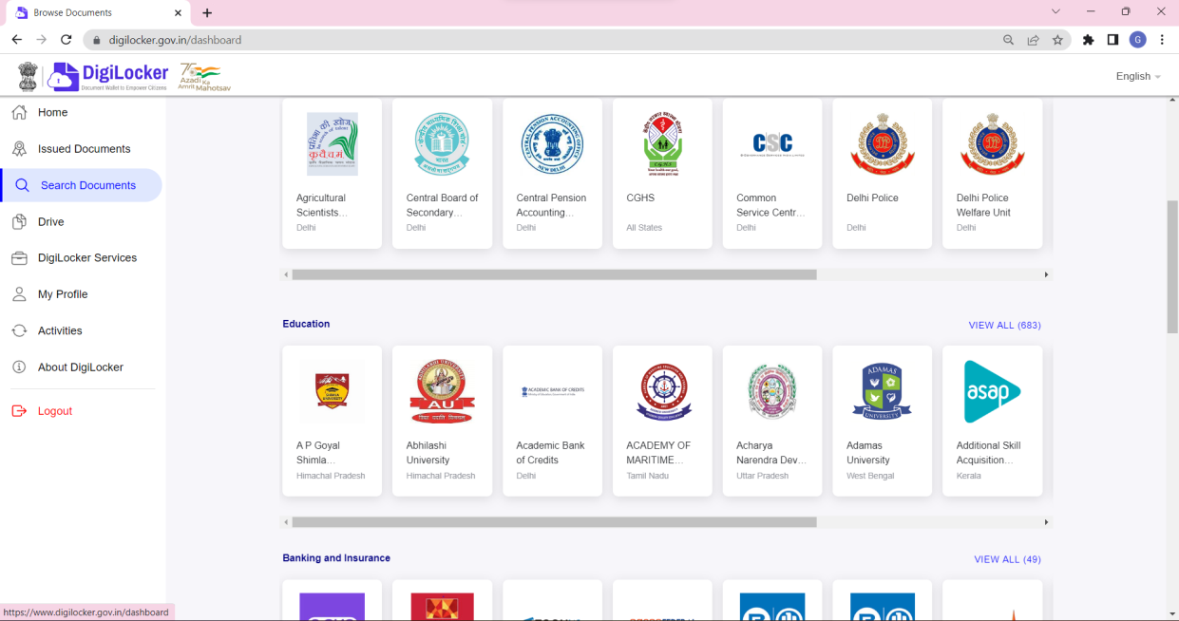
ABC ID Creation - DigiLocker
Sign In/Sign Up
Select Education Category
Go to ABC ID Creation service
Select Institution
Fetch ABC ID Card

Slide 6

ABC ID Creation
Sign In/Sign Up
Select Education Category
Go to ABC ID Creation service
Select Institution
Fetch ABC ID Card

Slide 7
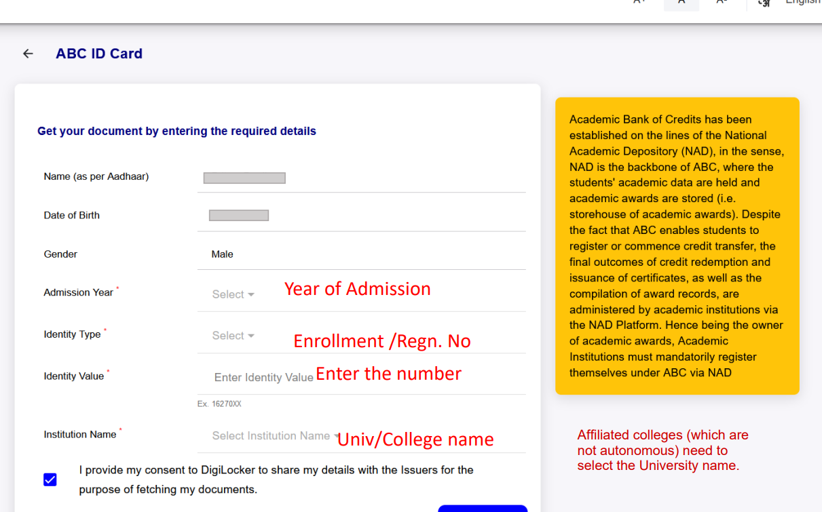

ABC ID Creation
Sign In/Sign Up
Select Education Category
Go to ABC ID Creation service
Select Institution
Fetch ABC ID Card

Slide 8
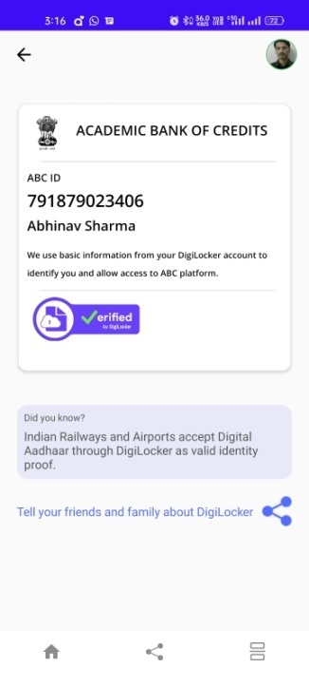
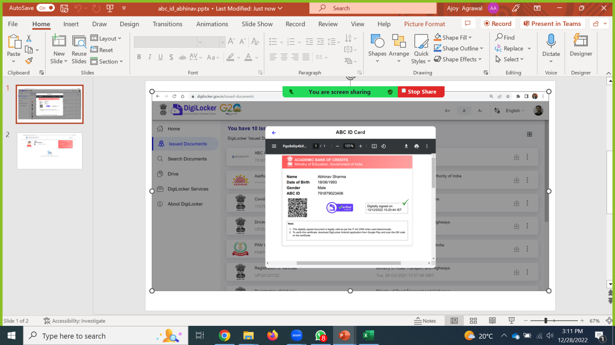
ABC ID Creation
Sign In/Sign Up
Select Education Category
Go to ABC ID Creation service
Select Institution
Fetch ABC ID Card
Document is available in the Issued Document Section

Slide 9
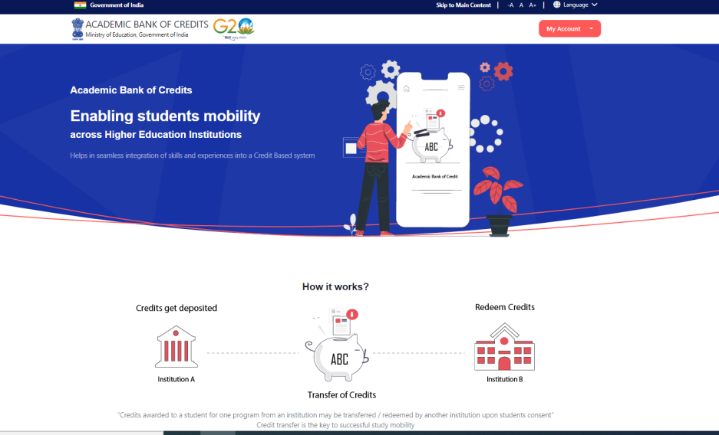
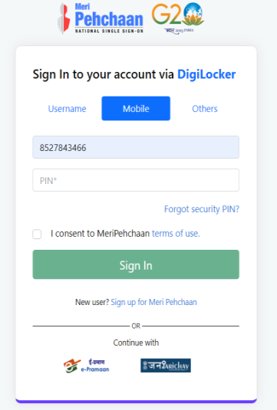

ABC ID Creation
ABC portal
www.abc.gov.in
Sign In/Sign Up
Select Institution
Create ABC ID
View Credit Score

Slide 10
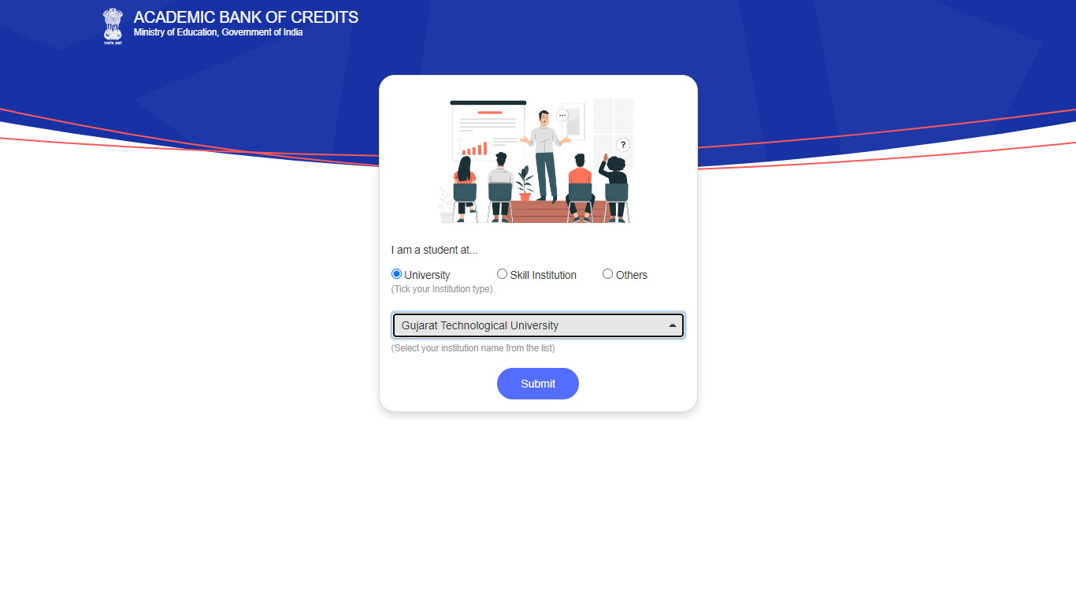

ABC ID Creation
ABC portal
Sign In/Sign Up
Select Institution
Create ABC ID
View Credit Score

Slide 11


ABC ID Creation
ABC portal
Sign In/Sign Up
Select Institution
Create ABC ID
View Credit Score

Slide 12


ABC ID Creation
ABC portal
Sign In/Sign Up
Select Institution
Create ABC ID
View Credit Score

